Slide 1
STRESSES AND DEFLECTION OF SPRINGS
By Dr. Andoh

Slide 2
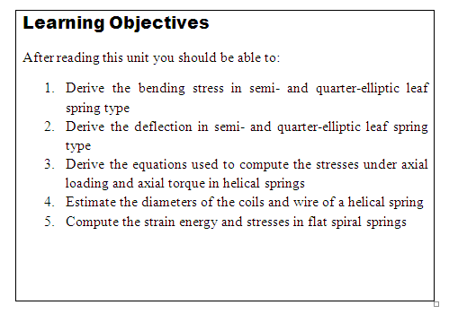

Slide 3
Introduction
CARRIAGE OR LEAF SPRINGS
Introduction
A spring is a device, in which the material is arranged in such a way that it can undergo a considerable change, without getting permanently distorted.
A spring is used to absorb energy due to resilience, which may be restored as and when required. The quality of a spring is judged from the energy it can absorb e.g., in a watch the spring is wound to absorb strain energy.
This energy is released to run the watch, when the spring regains its original shape. A carriage spring is used to absorb shocks. It is thus obvious that a spring which is capable of absorbing the greatest amount of energy for the given stress is known to be the best one.

Slide 4
Stiffness of a Spring
The load required to produce a unit deflection in a spring is called spring stiffness or stiffness of a spring.
Types of Springs
We have already discussed that a spring is used for absorbing energy due to resilience. Thus in general, the springs are of the following two types depending upon the type of resilience.
Bending spring
Torsion spring

Slide 5
Bending Spring: A spring which is subjected to bending only and the resilience is also due to it, is known a bending spring. Laminated springs or leaf springs are also called bending springs.
Torsion Spring: A spring, which is subjected to torsion or twisting moment only and the resilience, is also due to it is known as a torsion spring. Helical springs are also called torsion springs. Some springs arc subjected to bending as well as torsion.

Slide 6
Forms of Springs
Though there are many forms of springs, which are made by the manufacturers, yet the following types of springs are commonly used in Engineering practice.
Carriage springs or leaf springs
Helical springs.

Slide 7
Carriage Springs
These are also called laminated springs and are of two types:
semi-elliptical types (i.e., simply supported at its ends subjected to central load) and
quarter-elliptical (i.e., cantilever) types
The carriage springs are widely used in railway wagon, coaches and road vehicles the e day.
These are used to absorb shocks, which give an unpleasant feeling to the passengers. The energy absorbed by a laminated spring during a shock is released immediately without doing any useful work.

Slide 8
Helical Springs
It is a torsion spring and made up of a wire coiled into a helix. Though, there are many types of helical spring, yet the following are important from the subject point of view:
Closely-coiled helical springs and
Open-coiled helical springs.

Slide 9
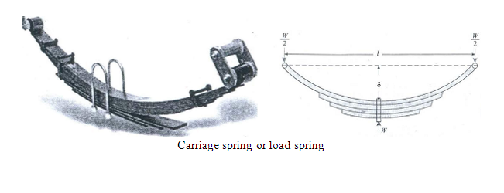
Semi-elliptical Type Leaf Springs
A laminated spring in its simplest form consists of a number of parallel strips of a metal having different lengths but same width and placed one over the other in laminations as shown in Fig. 28.1.

Slide 10
All the plates are initially bent to the same radius and arc free to slide one over the other. When the spring is loaded to the designed load, all the plates become flat and the central deflection disappears.
The purpose of this type of arrangement of plates is to make the spring of uniform strength throughout. This is achieved by tapering the ends of the laminations. The semi-elliptical type spring rests on the axis of the vehicle and its top plate is pinned at the end to the chassis of the vehicle.

Slide 11
Now consider a carriage spring pinned at its both ends, and carrying an upward load at its centre as shown in Fig. 28.l.
Let l Span of the spring,
t Thickness of plates,
b Width of the plates,
n Number of plates,
W Load acting on the spring
σ Maximum bending stress developed in the plates,
δ Original deflection of the top spring and
R Radius of the spring

Slide 12
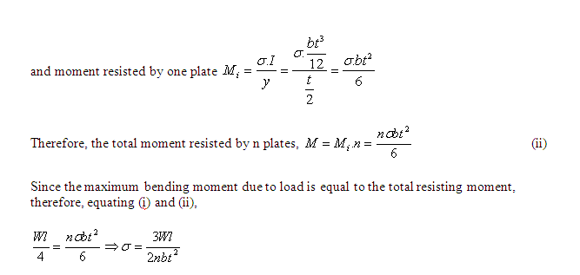
A little consideration will show that the load will be acting on the spring on the lowermost plate and it will be shared equally on the two ends of the top plate as shown in Fig. 28.1.
We know that the bending moment, at the centre of the span due to this load

Slide 13
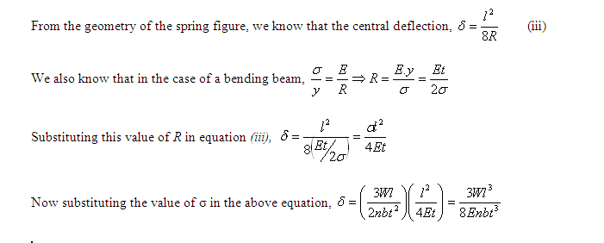

Slide 14
Example 5-1:
A laminated spring 1 m long is made up of plates each 50 mm wide and 10 mm thick. If the bending stress in the plates is limited to 100 MPa, how many plates are required to enable the spring to carry a central point load of 2 kN. If modulus of elasticity for the spring material is 200 GPa, what is the deflection under the load?

Slide 15
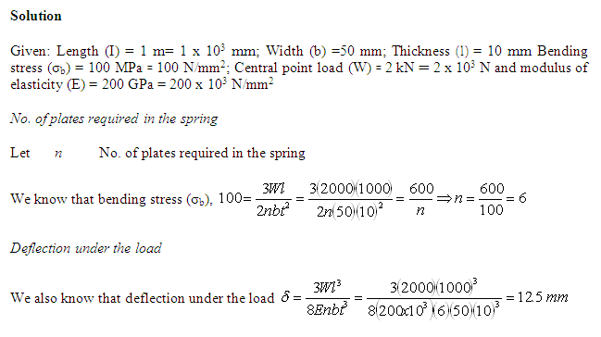

Slide 16
Example 5-2:
A leaf spring is to be made of seven steel plates 65 mm wide and 6.5 min thick. Calculate the length of the spring, so that it may carry a central load of 2.75 kN, the bending stress being limited to 160 MPa. Also calculate the deflection at the centre of the spring. Take E for the spring material as 200 GPa.

Slide 17
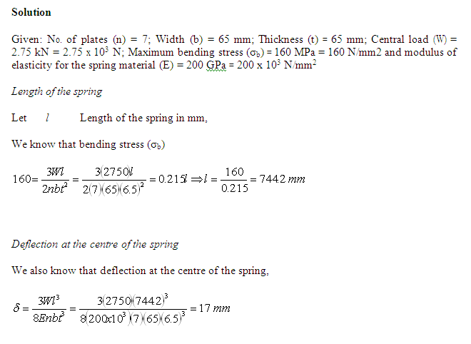

Slide 18
Example 5-3:
A leaf spring 750 mm long is required to carry a central point load of 8 kN. If the central deflection is not to exceed 20 mm and the bending stress is not greater than 200 MPa, determine the thickness, width and number of plates. Also, compute the radius, to which the plates should be curved. Assume width of the plate equal to 12 times its thickness and E equal to 200 GPa.

Slide 19
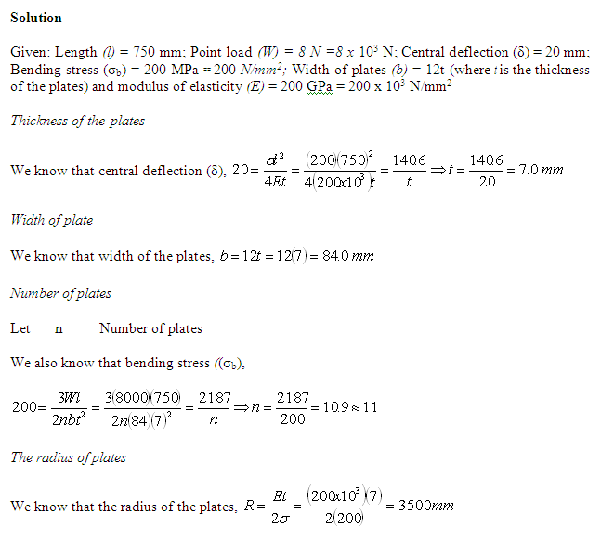

Slide 20
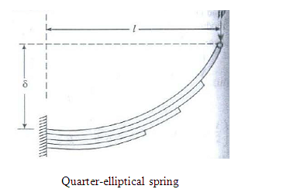
Quarter-Elliptical Type Leaf Springs
The quarter-elliptical type leaf springs are rarely used except as certain parts in some machines.
Like a carriage spring, a quarter-elliptical type leaf spring consists of a number of parallel strip of a metal having different lengths but same width and placed one over the other in laminations as shown in Fig. 28.2. All the plates are initially bent to the same radius and are free to slide one over the other.

Slide 21
Now consider a quarter-elliptical type leaf spring subjected to a load at its free end as shown in Fig. 28.2.
Let l Length of the spring,
t Thickness of the plates,
b Width of the plates,
n Number of plates,
W Load acting at the free end of the spring, and
δ Original deflection of the spring.

Slide 22
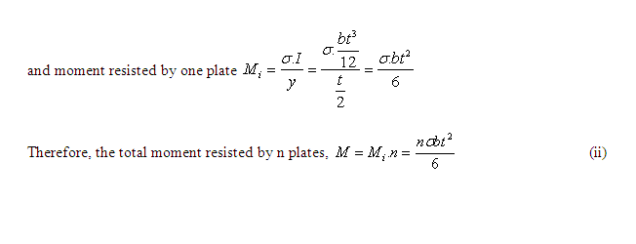
We know that the bending moment at the fixed end of the leaf,
….. (i)

Slide 23
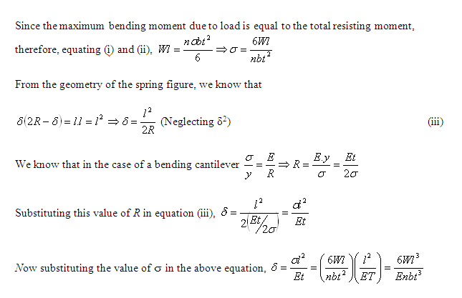

Slide 24
Example 5-4:
A quarter-elliptic leaf spring 800 mm long is subjected to a point load of 10 kN. If the bending stress and deflection is not to exceed 320 MPa and 80 mm respectively, find the suitable size and number of plates required by taking the width as 8 times the thickness. Take E as 200 GPa.

Slide 25
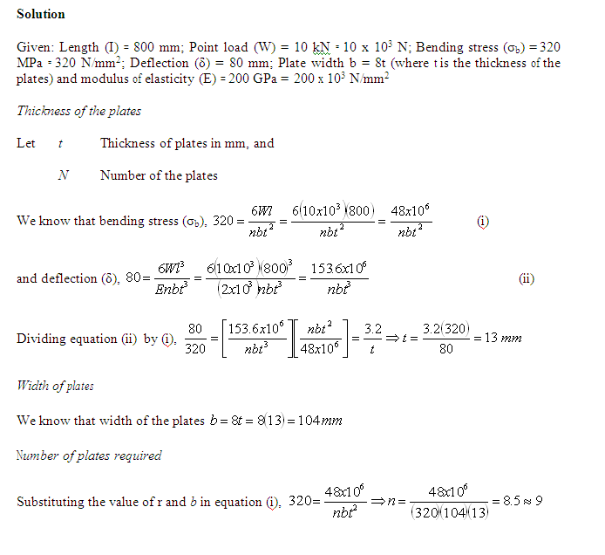

Slide 26
Self Assessment
1. Derive the equations for the deflection and bending stress for a semi-elliptic type leaf spring

Slide 27
HELICAL SPRINGS
Closely-coiled Helical Springs
In a closely coiled helical spring, the spring wire is coiled so close that the each turn is practically a plane at right angles to the axis of the helix and the wire is subjected to torsion. The bending stress is negligible as compared to the torsional stress. A closely-coiled helical spring may be subjected to:
axial loading and
axial twist
In this session, we shall discuss both the cases one by one.

Slide 28
Consider a closely-coiled helical spring subjected to an axial load as shown in Fig. 28.3.
Let
d Diameter of the spring wire, ,
R Mean radius of the spring coil
n No. of turns of coils,
C Modulus of rigidity for the spring material,
W Axial load on the spring
τ Maximum shear stress induced in the wire due to twisting,
θ Angle of twist in the spring wire and
δ Deflection of the spring, as a result of axial load

Slide 29
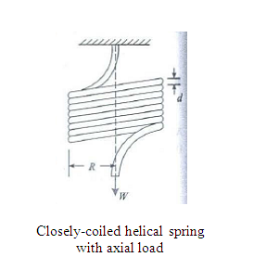

Slide 30
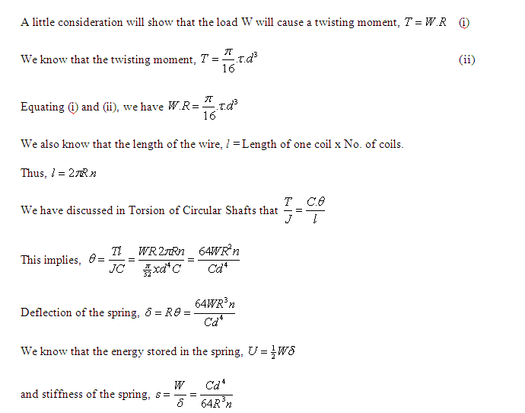

Slide 31
Example 5-5:
A close-coiled helical spring is required to carry a load of 150 N. if the mean coil diameter is to be 8 times that of the wire, calculate these diameters. Take maximum shear stress as 100 MPa.

Slide 32
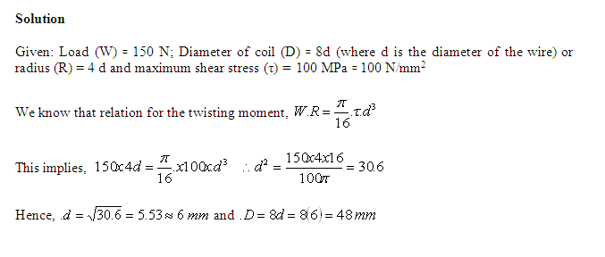

Slide 33
Example 5-6:
A closely. coiled helical spring of round steel wire 5 mm in diameter having 12 complete coils of 50 mm mean diameter is subjected 10 an axial load of 100 N. Find the deflection of the spring and the maximum shearing stress in the material. Modulus of rigidity (G) = 80 GPa

Slide 34
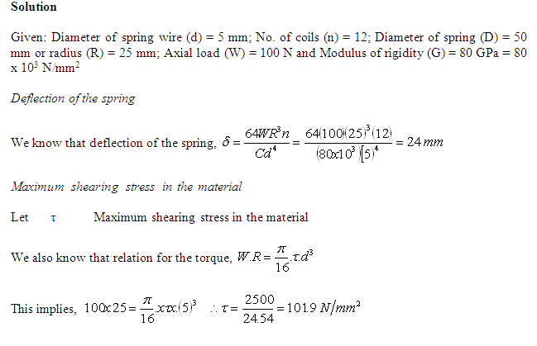

Slide 35
Closely-coiled Helical Springs Subjected to an Axial Twist
Consider a closely-coiled helical spring subjected to an axial twist as shown in Fig. 28.4.
Let
  d Diameter of the spring wire,
R Mean radius of the spring coil,
n No. of turns of coils,
e Modulus of rigidity for the spring material and
M Moment or axial twist applied on the spring.

Slide 36
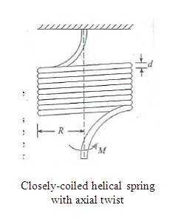

Slide 37
A little consideration will show that the number of spring coils will tend to increase or decrease depending upon the sense of the moment. Moreover, if the number of turns tend to increase, then the mean radius of the spring coil will decrease. ]
Now let us consider that the number of turns increase from n to n' and the mean radius decrease from R to R'.

Slide 38
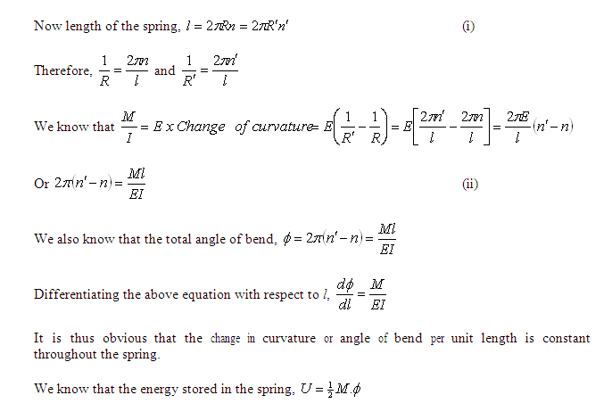

Slide 39
Example 5-7:
A closely-coiled helical spring is made lip of 10 nun diameter steel wire having 10 coils with 80 mm mean diameter. If the spring is subjected 10 an axial twist of 10 kN­mm, determine the bending stress and increase ill the number of turns. Take E as 200 GPa.

Slide 40
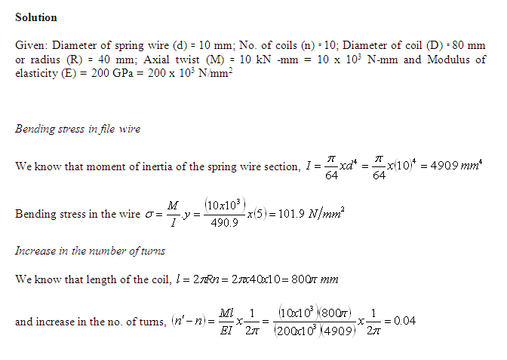

Slide 41
Open-coiled Helical Springs
In an open helical spring, tile spring wire is coiled in such a way, that there i large gap between the two consecutive turns. As a result of this, the spring can take compressive load also.
An open helical spring, like a closed helical spring, may be subjected to (1) axial loading or (2) axial twist.
In this session, we hall discuss only the first case.

Slide 42
Now consider an open coiled helical spring subjected to an axial load as shown in Fig. 28.5.
Let
d Diameter of the spring wire,
R Mean radius of the spring coil,
P Pitch of the spring coils,
n No. of turns of coils,
C Modulus of rigidity for the spring materials
W Axial load on the spring,
τ Maximum shear stress induced in the spring wire due to loading,
σ_{b} Bending stress induced in the spring wire due to bending,
δ Deflection of the spring as a re­sult of axial load and
α Angle of helix.

Slide 43
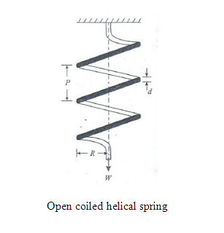

Slide 44
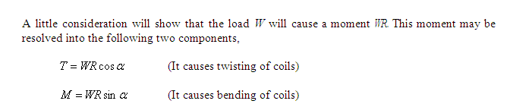
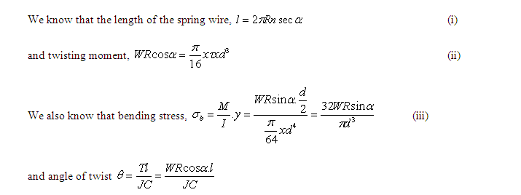
Let
δ Angle of twist, as a results of twisting moment
ϕ Angle of bend, as a results of bending moment

Slide 45
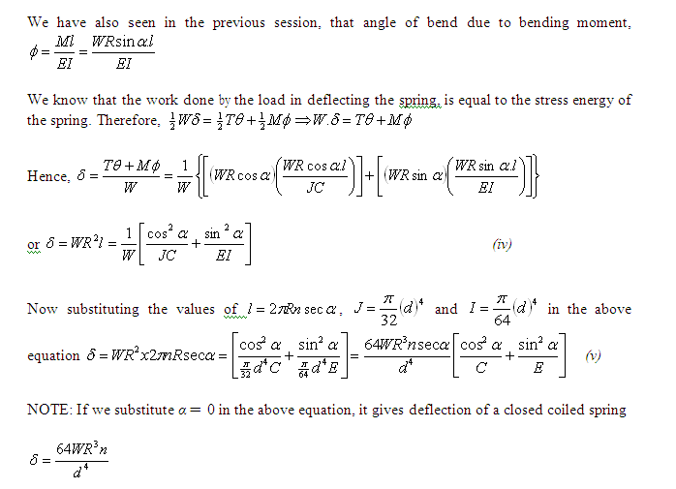

Slide 46
Example 5-8:
An open coil helical spring made up of 10 nun diameter wire and of mean diameter of 100 mm has 12 coils and angle of helix being 15°. Determine the axial deflection and the intensities of bending and shear stresses under an axial load of 500 N. Take C as 80 GPa and E as 200 GPa.

Slide 47
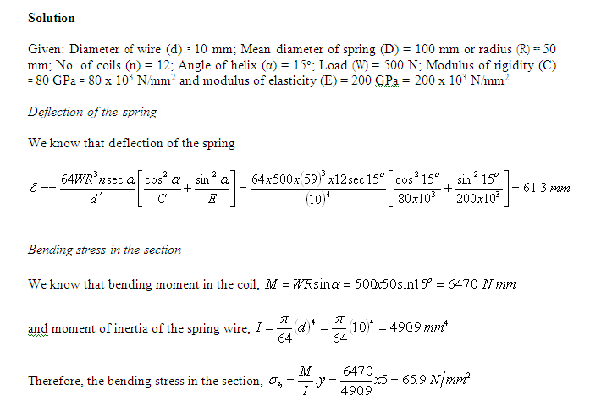

Slide 48
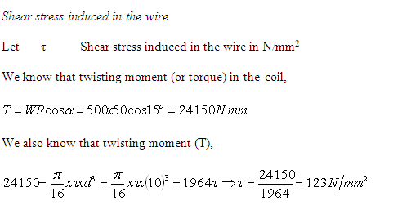

Slide 49
Flat Spiral Springs
This is the type of spring used in clockwork mechanisms, and consists of a uniform thin strip wound into a spiral in one plane, and pinned at its outer end.
The spring is "wound up" by applying a torque to a spindle attached to the centre of the spiral.

Slide 50
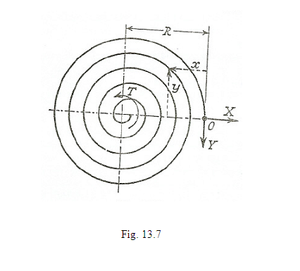
Let T be the torque tending X to wind up the spring, and X and Y the components of reaction at the outer end of the spring a (Fig. 13.7).

Slide 51
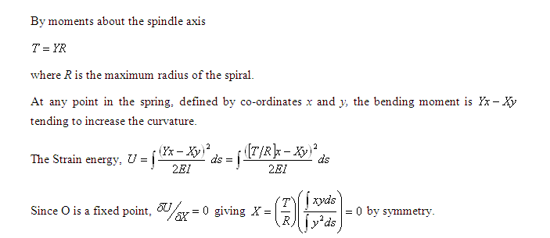

Slide 52
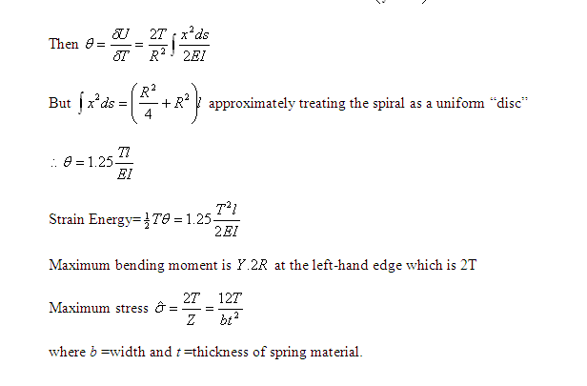

Slide 53
Example 5-9:
A fiat spiral spring is 6 mm wide, 0·25 mm thick, and 2,5 mm long, Assuming the maximum stress of 800 N/mm² to occur at the point of greatest bending moment, calculate the torque, the work stored, and the number of turns to wind up the spring, E =208,000 N/mm².

Slide 54
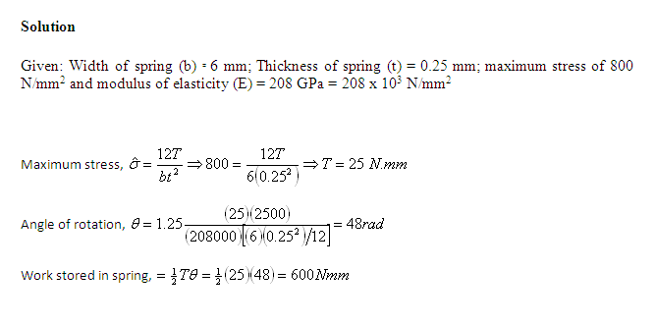

Slide 55
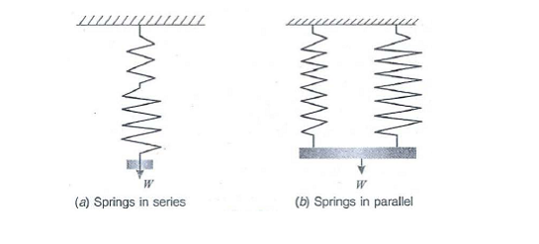
Springs in Series and Parallel
In the previous session we have been discussing the use of one helical spring only. But sometimes two (or even more) springs are used at one place.
Though there are many ways of using these springs, yet the springs in (i) series and (ii) parallel are important from the subject point of view.

Slide 56
Springs in series
In this case, the two springs are connected in series as shown in Fig. 28.6 (a). Each spring is subjected to the same load applied at the end of one spring.
A little consideration will show that the total extension of the assembly is equal to the algebraic sum of the extensions of the two springs
Springs in parallel
In this case, the two springs are connected in parallel as shown in Fig. 28.6 (b).
The extension of each spring is the same. A little consideration will show that the load applied on the assembly is shared by the two springs.

Slide 57
Example 5-10:
Two-close coiled helical springs wound from the same wire, but with different core radii having equal no. of coils are compressed between rigid plates at their ends. Calculate the maximum shear stress induced in each spring, if the wire diameter is 10 mm and the load applied between tile rigid plates is 500 N. The core radii of the springs are 100 mm and 75 mm respectively.

Slide 58
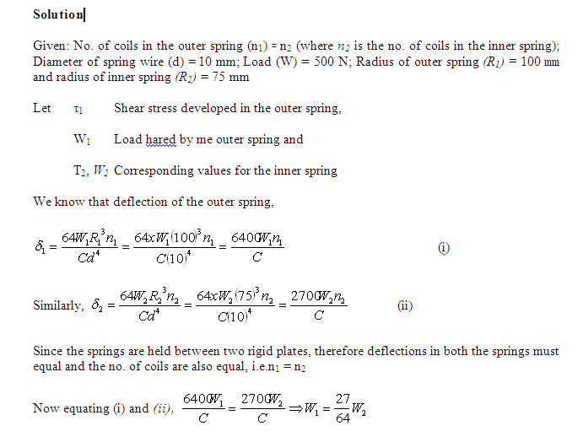

Slide 59
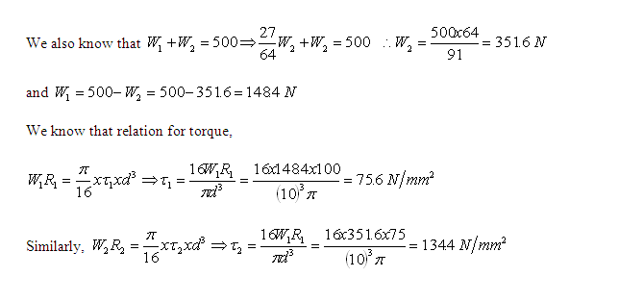

Slide 60
Self Assessment 2-5
1. Derive the equations for the deflection and bending stress for a closed-coiled helical spring

Slide 61
Unit Summary
A spring is a flexible element used to exert a force or a torque and, at the same time, to store energy.
The force can be a linear push or pull, or it can be radial, acting similarly to a rubber band around a roll of drawings.
The torque can be used to cause a rotation, for example, to close a door on a cabinet or to provide a counterbalance force for a machine element pivoting on a hinge.
Springs inherently store energy when they are deflected and return the energy when the force that causes the deflection is removed.
When this is the primary design objective, the spring is frequently referred to as a power spring or motor spring.

Slide 62
Review Question
A close-coiled helical spring has to absorb 60 Nm of energy when compressed 6 cm. The diameter is nine times the wire diameter. If there are twelve coils, estimate the diameters of coils and wire and the maximum shear stress. G==95,000 N/mm².

Slide 63
Discussion Question
A composite spring has two close-coiled helical springs connected in series; each spring has ten coils at a mean diameter of 40 mm. Find the wire diameter in one if the other is 3.0 mm and the stiffness of the composite spring is 800 N/m. Estimate the greatest load that can be carried by the composite spring, and the corresponding extension, for a maximum shearing stress of 280 N/mm².
G =90,000 N/mm².

Slide 64
Quizzes
Derive from first principles, making usual assumptions the formula for the maximum stress and or the central deflection of a leaf spring consisting of n leaves and subjected to central load.
What are helical springs? Differentiate between a closely coiled helical spring and an coiled helical spring.
A closely coiled helical spring with D as diameter of the coil and d as diameter of the wire subjected to an axial load W. Prove that the maximum shear stress produced is equal to
Derive an equation for the deflection of an open coiled helical spring.

Slide 65
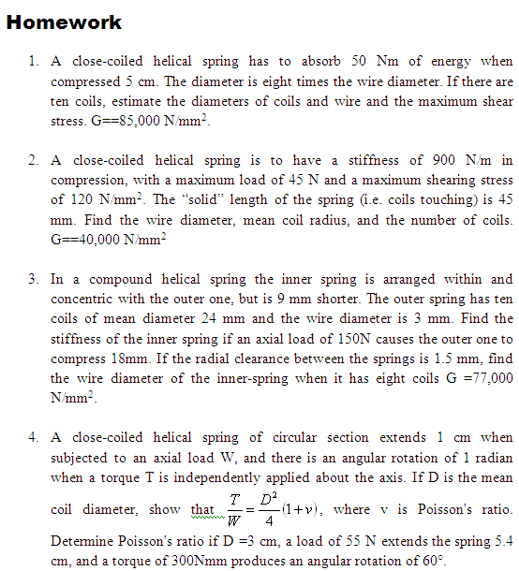

Slide 66
